Slide 1
Embedded Linux
2023/04/25
劉正文

Slide 2
Linux
Hard real-time 作業系統伴隨著巨大的維護成本
Linux作為通用作業系統開發的，其核心在即時處理能力上先天不足
部分網路開發社群將其改造能在一定程度上成為即時作業系統
Linux 核心主流的解決方案就是 PREEMPT_RT
Linux 核心從對一個即時行程 (realtime process) 予以排程，到該即時行程實際投入執行之間的延遲時間 (稱為 latency) 行為上”不可預測”，因此無法給予有著硬即時需求的任務任何保證，自然不可能滿足即時需求
PREEMPT_RT 將中斷處理轉化為核心執行緒，保證它不再佔用任意 context，這保證即便中斷被即時行程搶佔，也不會連累無辜地被它佔用核心堆疊的行程

Slide 3
Solution
RTOS
FreeRTOS
RTEMS
RT-Linux
VxWorks
μC/OS-Ⅱ
LEON3
SPARC V7、V8
Raspberry pi
Broadcom BCM2837
1.2 GHz 64-bit quad-core ARM Cortex-A53
SAMRH71
Rad-Hard Arm® Cortex®-M7 Microprocessor

Slide 4
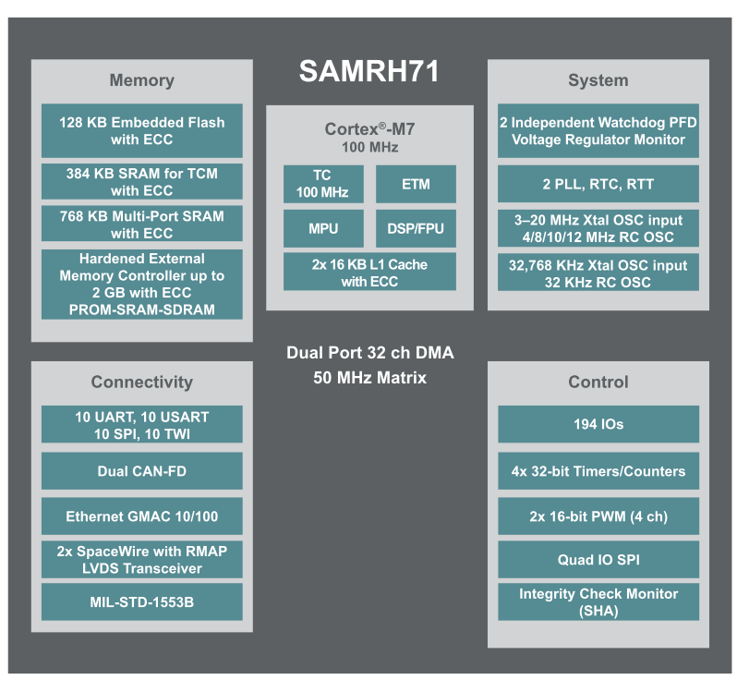
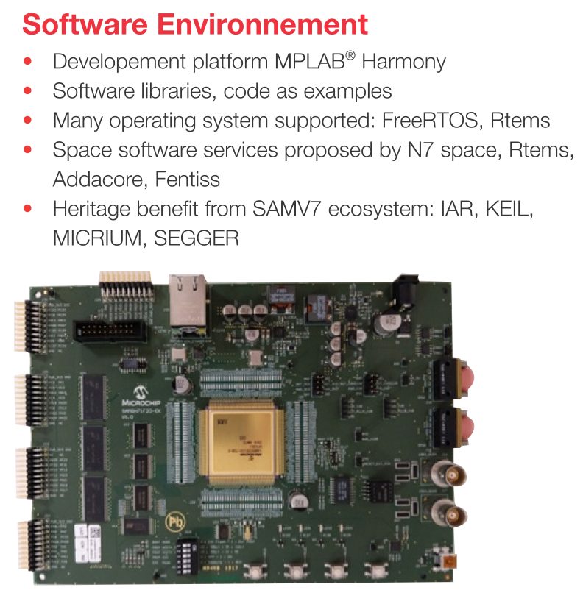
SAMRH71

Slide 5
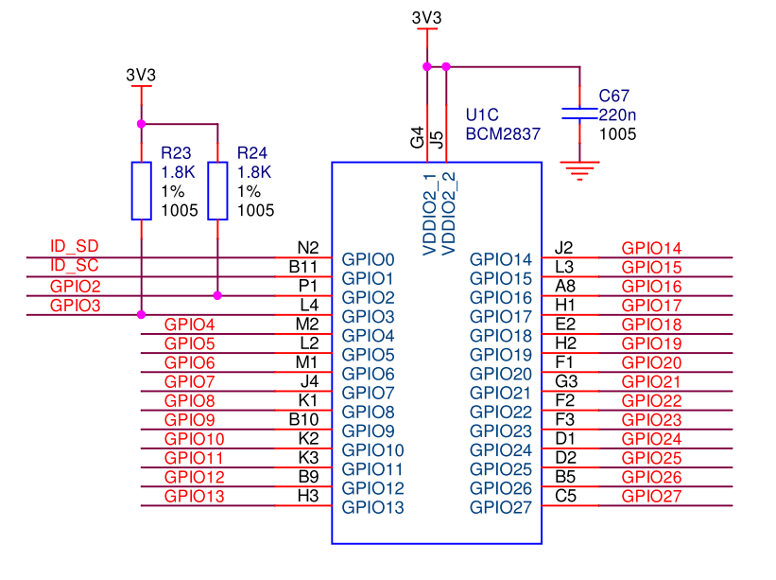
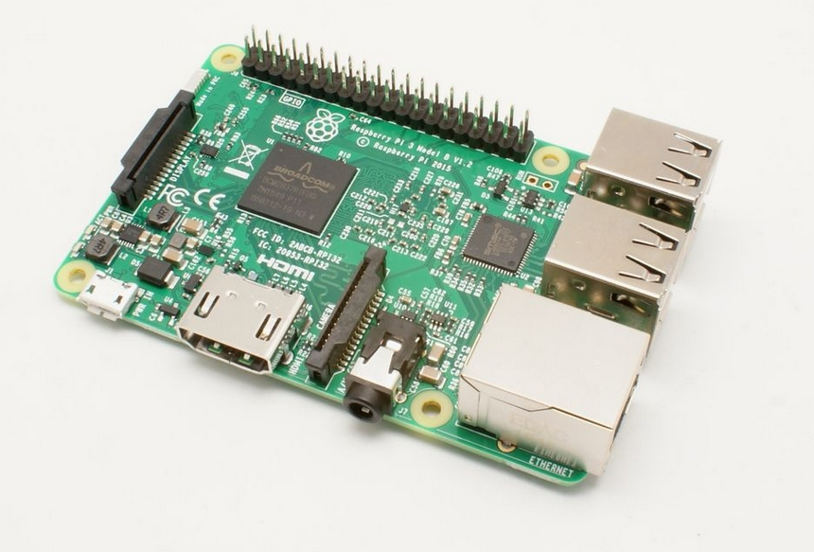
Raspberry Pi 3B

Slide 6
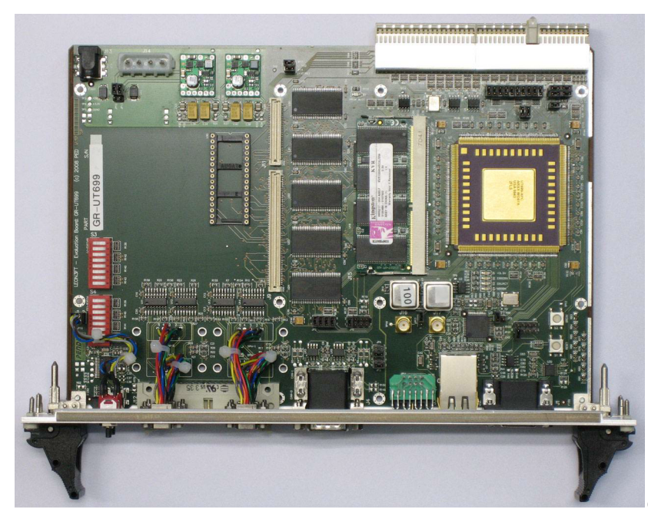
LEON3 UT-699

Slide 7
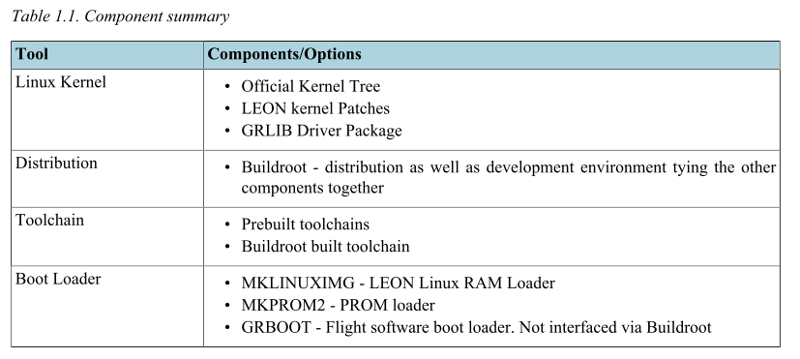
LEON Linux Overview

Slide 8
GRLIB IP-cores
LEON3, LEON4, LEON5 (all in single or multicore configurations)
MMU, V8, FPU
GPTIMER System Clock Timer
IRQMP or IRQAMP interrupt controller
APBUART system console
GRETH 10/100 and 10/100/1000 Network driver using the MDIO layer of the Linux kernel
GRPCI or GRPCI2 PCI Host support
GRUSBHC USB 1.1/2.0 Host controller
GRUSBDC USB 1.1/2.0 Device controller
GRVGA Graphical Frame Buffer
GRPS2 mouse/keyboard PS/2 controller
GRCAN and OCCAN implements the Linux socket CAN 2.0b interface
GRGPIO supports the generic General Purpose I/O model of Linux
SPICTRL supports SPI master interface through the spi-fsl driver
I2CMST support I2C master interface through the i2c-ocores driver

Slide 9
Buildroot distribution
LEON Buildroot 2022.02-1.x
LEON specific documentation about Buildroot is found in the LEON Buildroot User's Manual
RAM images with MKLINUXIMG
Create bootable ROM images from the RAM images with MKPROM
GNU GCC toolchain

Slide 10
Hardware Requirements
LEON3, LEON4 or LEON5
SPARC V8 mul/div
MMU
GPTIMER for system clock
IRQMP or IRQ(A)MP for interrupt support
D-Cache snooping
FPU
32 MiB RAM

